Slide 1

Mini Project
CHEF GEINE
BY
Mahboob Hasan Yash Mishra Yash Sharma

Slide 2

INTRODUCTION
A Chef geine is a revolutionary tool that simplifies the process of writing introductions for recipes. By analyzing various recipe databases and using advanced algorithms, it generates engaging and concise introductions that capture the essence of the dish. This system saves time and effort for recipe creators, allowing them to focus on the actual cooking process.

Slide 3
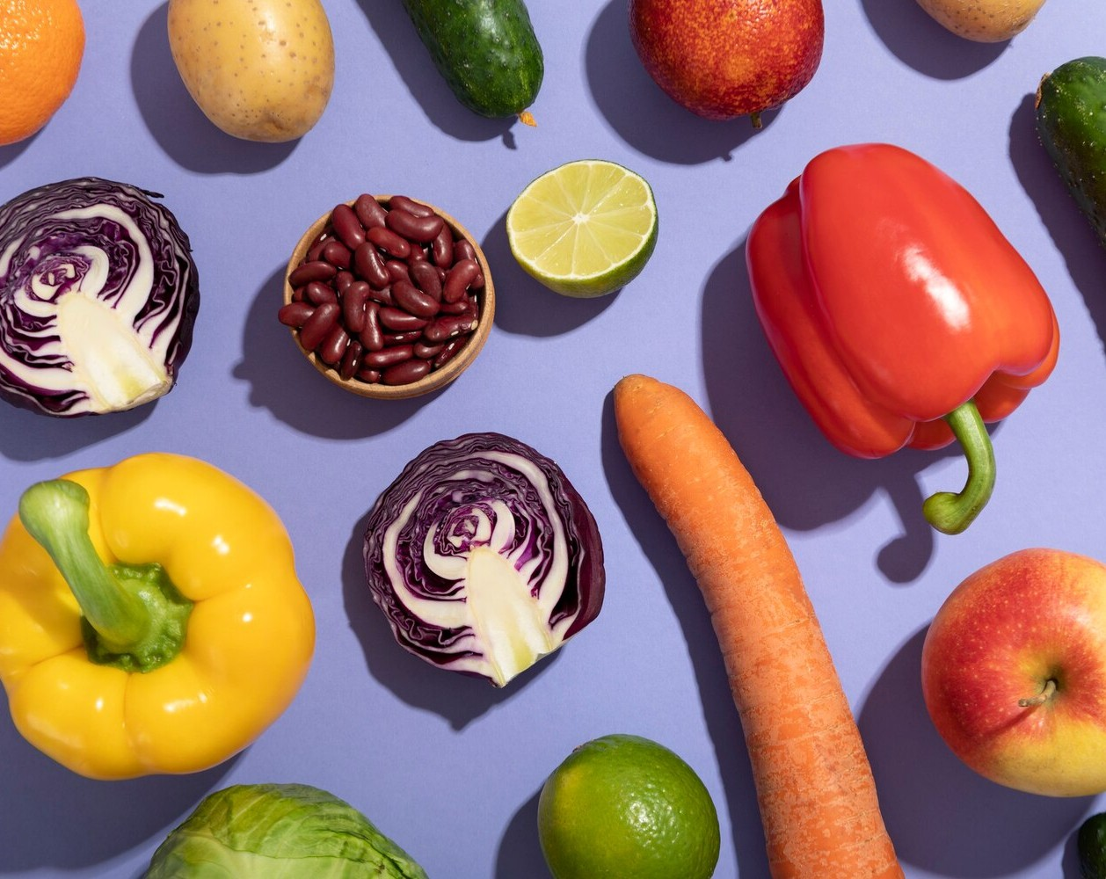
CHEF GEINE'S INSPIRATION
Chef Geine, your culinary artistry is truly inspiring. Your ability to transform simple ingredients into exquisite dishes is a testament to your creativity and passion. Your dedication to perfection and your constant pursuit of innovation continue to amaze and delight. Keep cooking with love and continue to inspire others with your culinary masterpieces.

Slide 4

PURPOSE
The purpose of Recipe Genie is to simplify the process of finding and creating recipes. With a vast database of recipes from various cuisines, users can easily search for specific dishes or ingredients. The platform also offers personalized recommendations, saving time and effort in meal planning. Recipe Genie aims to inspire and assist users in their culinary adventures.

Slide 5

SCOPE
Chef Genie is one of the applications to improve the information of any particular Recipe System. This application involves almost all the features of the Chef Genie; the implementation will be online help for the users to obtain recipe information.

Slide 6
FUNCTIONAL REQUIREMENTS
User Authentication and Authorization Recipe Management
Search and Filter
Recipe Sharing

Slide 7
Non-Functional Requirements
Usability Performance Reliability Documentation Testing

Slide 8

Hardware Requirements
Processor
Intel Pentium Intel core i3 Ryzen
RAM 2GB (Minimum)

Slide 9

Software Requirements
Operating System:
Windows 8/10/11 /Linux /MacOS
Web Browser:
Chrome/ Microsoft edge/Brave/Mozilla Firefox
Web Designing:
MERN

Slide 10

Software Requirement Specification
External & Internal Interfaces
Database Integration
API’s
Cloud Data Storage
Authentication Services

Slide 11
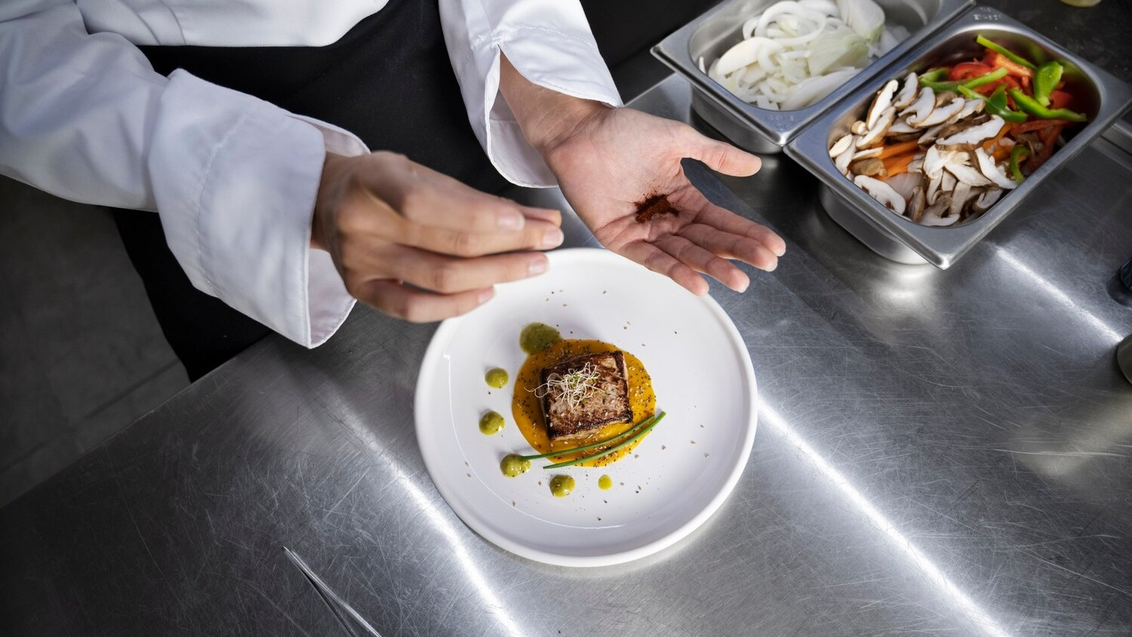
User Interface
Home Page
Navigation
Recipe Card
Recipe Details
User Profile
Responsive Design
Searching & Shorting

Slide 12

Hardware Interface
Server
Database Server
Storage Devices
Networking Components
Client Devices
Input Devices
Output Devices
Security Devices

Slide 13

Software Interfaces
User Interface
Recipe Input Interface
Recipe Search Interface
Recipe Display Interface
Authentication & Security Interface

Slide 14
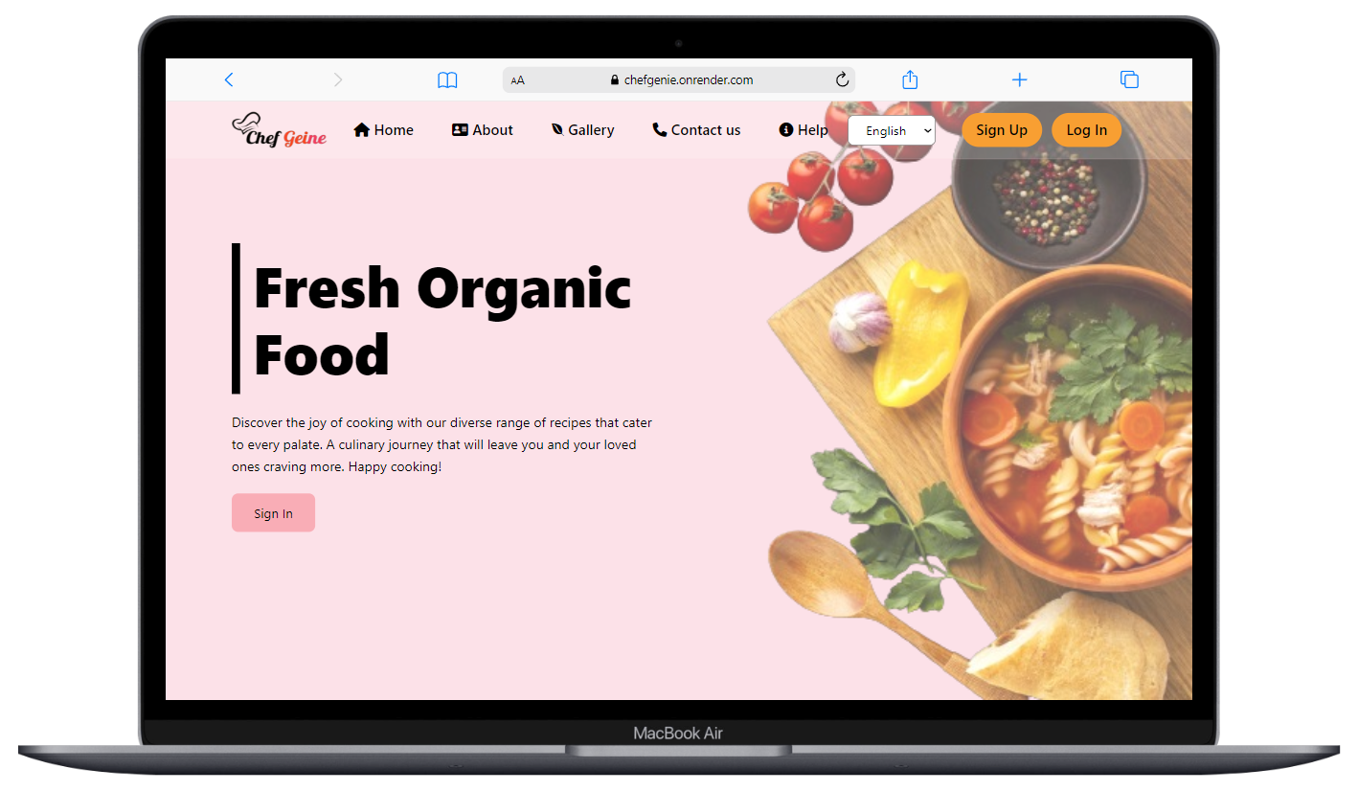
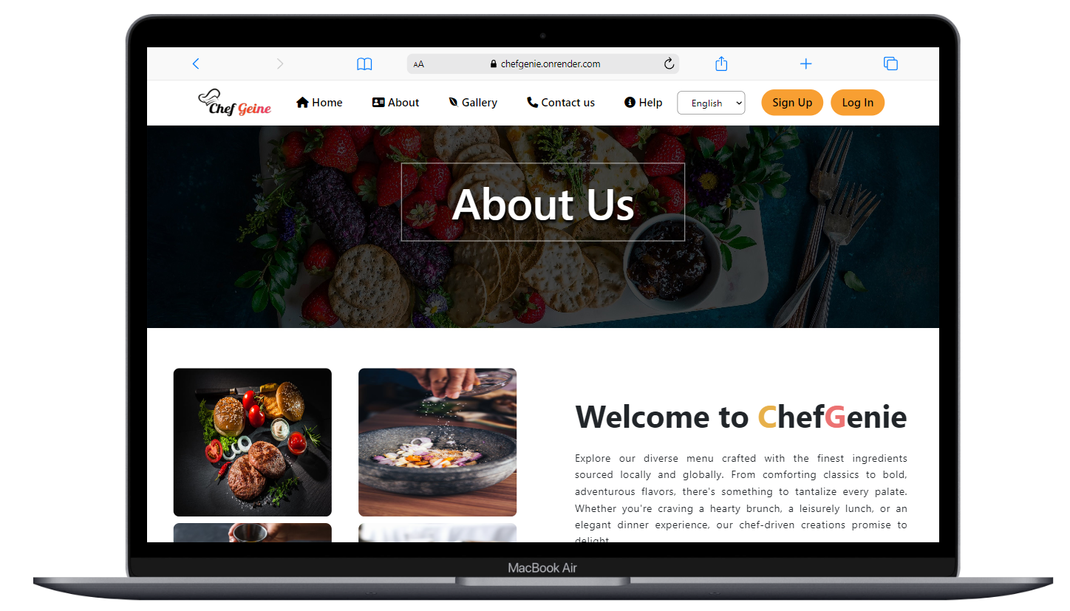
Project Overview

Slide 15
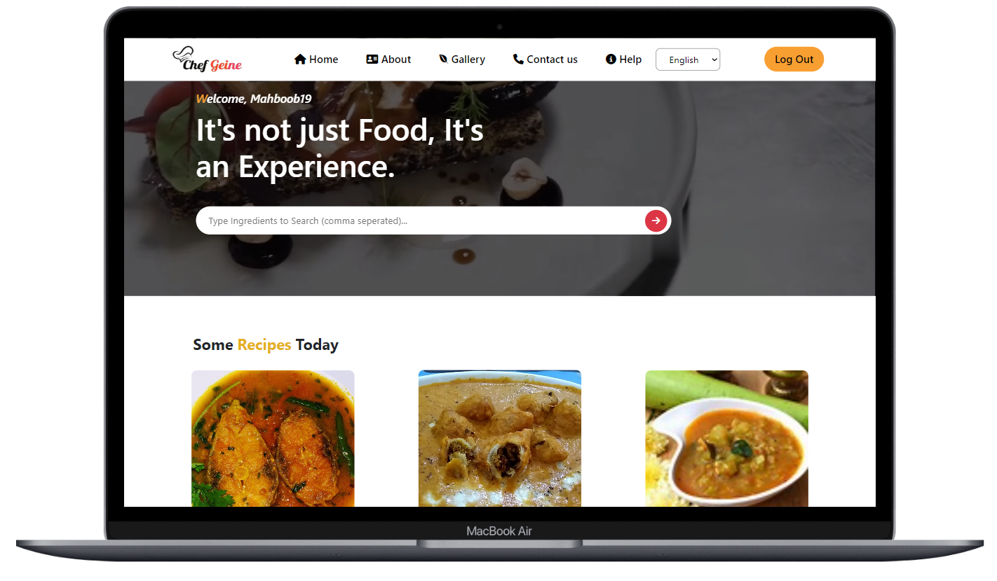
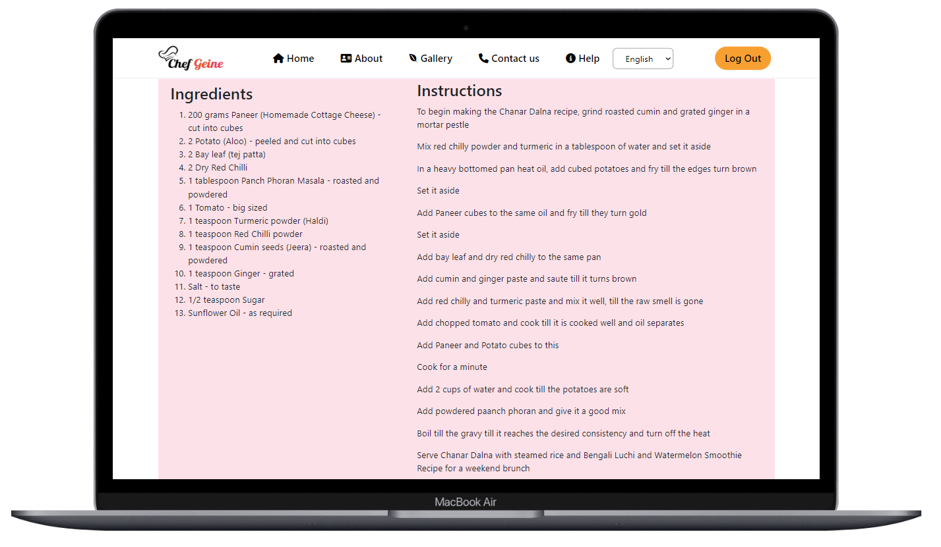

Slide 16
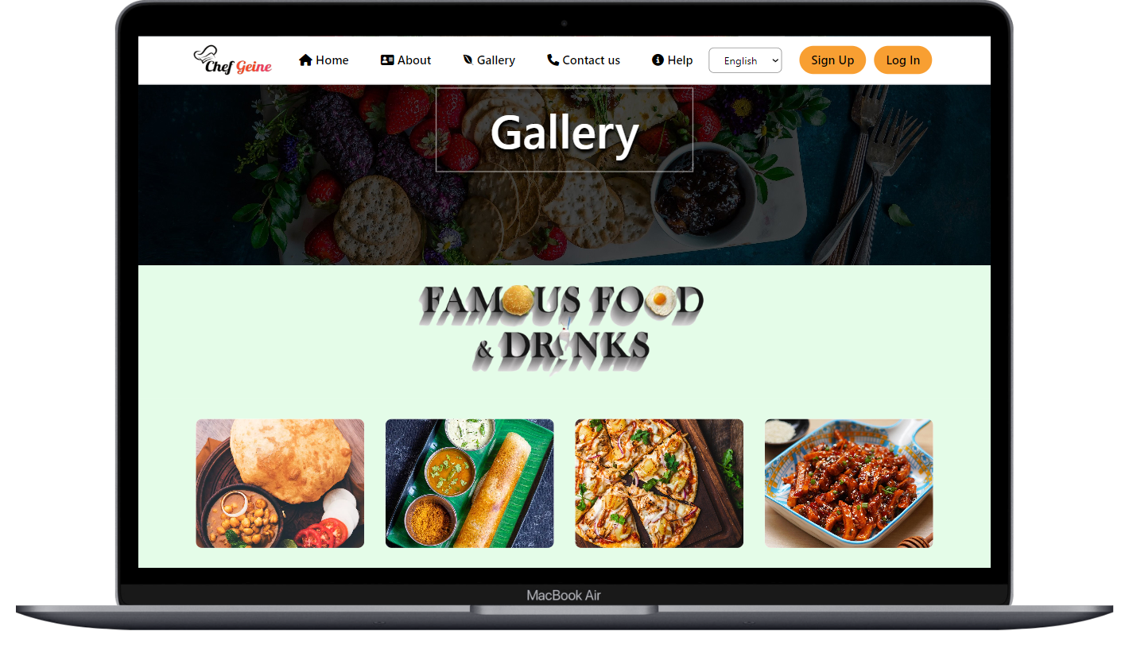
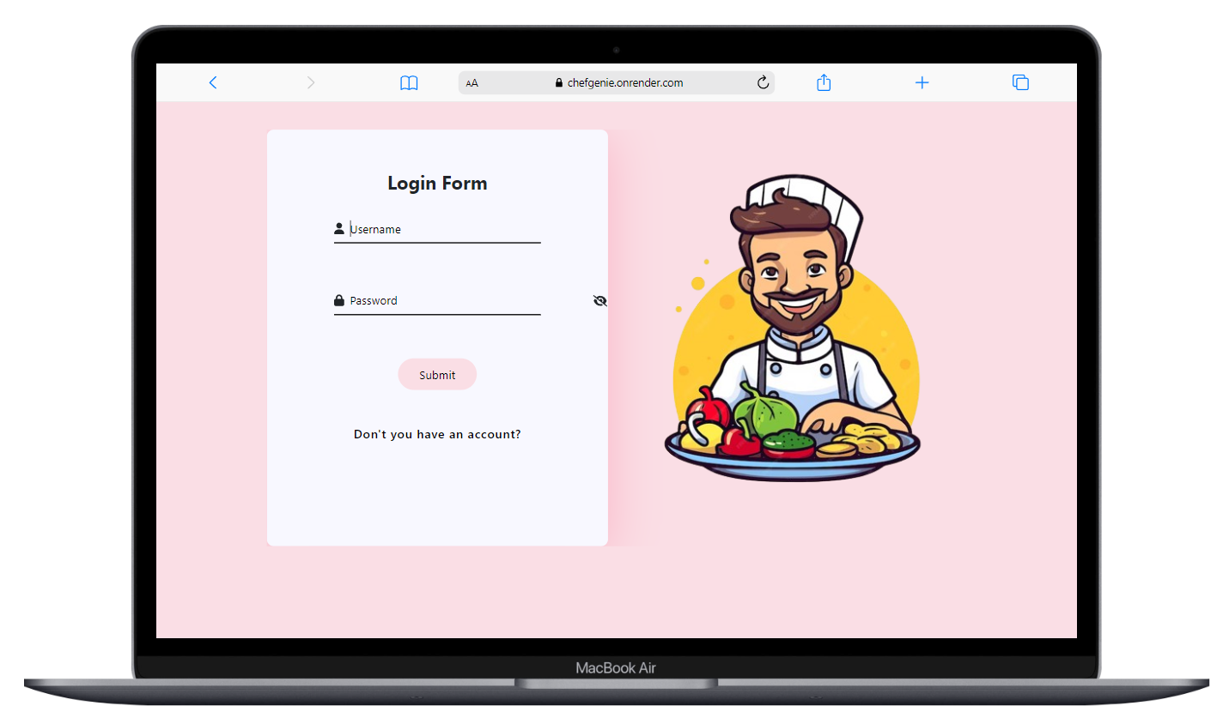

Slide 17
CONCLUSION
A well-crafted conclusion for a recipe should summarize the main steps and highlight the delicious outcome. It can also include serving suggestions or variations. Remember to use clear and concise language, ensuring that the reader feels confident and excited to try the recipe.

Slide 18





